Slide 1

PW Looking Forward
Celebrating
PW’s Past, Present
and Future

Slide 2

Introduction
How is PW liv­ing out the PW Purpose?
How do we will fulfill our purpose going forward?

Slide 3
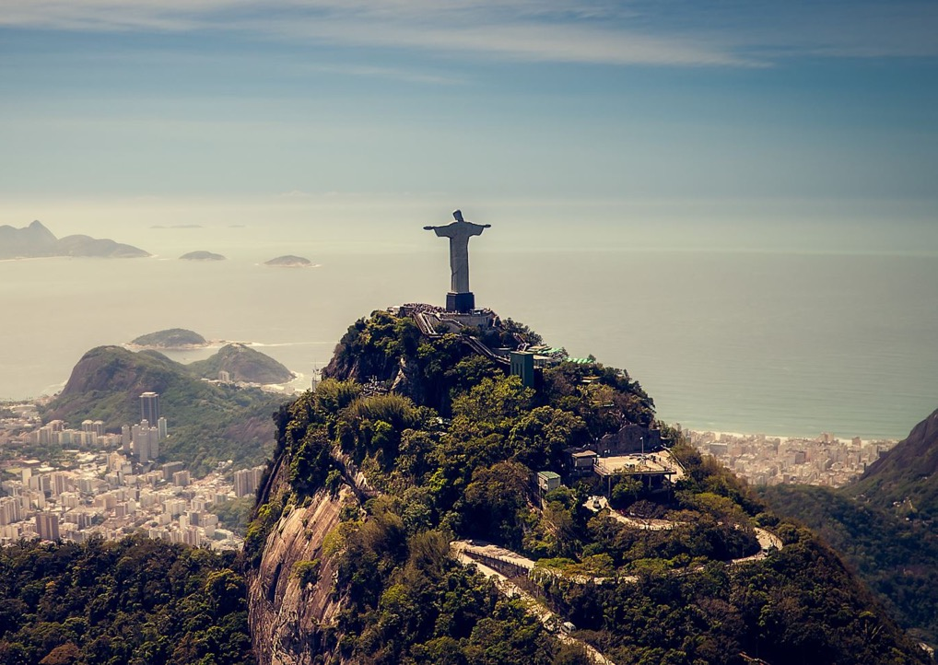
Forgiven and freed by God in Jesus Christ and empowered by the
Holy Spirit

Slide 4
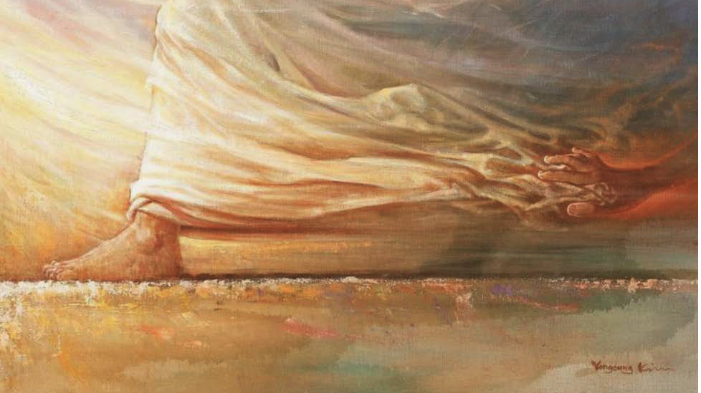
We commit ourselves to nurture our faith through prayer and Bible study

Slide 5


Fellowship of the Least Coin
Prayer Movement
PW Giving, 2023–2024, $92,681.55
PW, Inc., Fiscal Agent,
Provides the International Treasurer

Slide 6


World Day of Prayer
2025 Service, March 7, 2025
I Made You Wonderful
Service written by the World Day of Prayer Committee, Cook Islands
International Committee, PW Treasurer

Slide 7

2024–2025
PW/Horizons
Bible Study
Let Justice Roll Down
God’s Call to Care for Neighbors
and All Creation
By Patricia K Tull
Suggestions for Leaders By
Rebecca Barnes
Additional Resources in Horizons, PW Website, PW Store

Slide 8
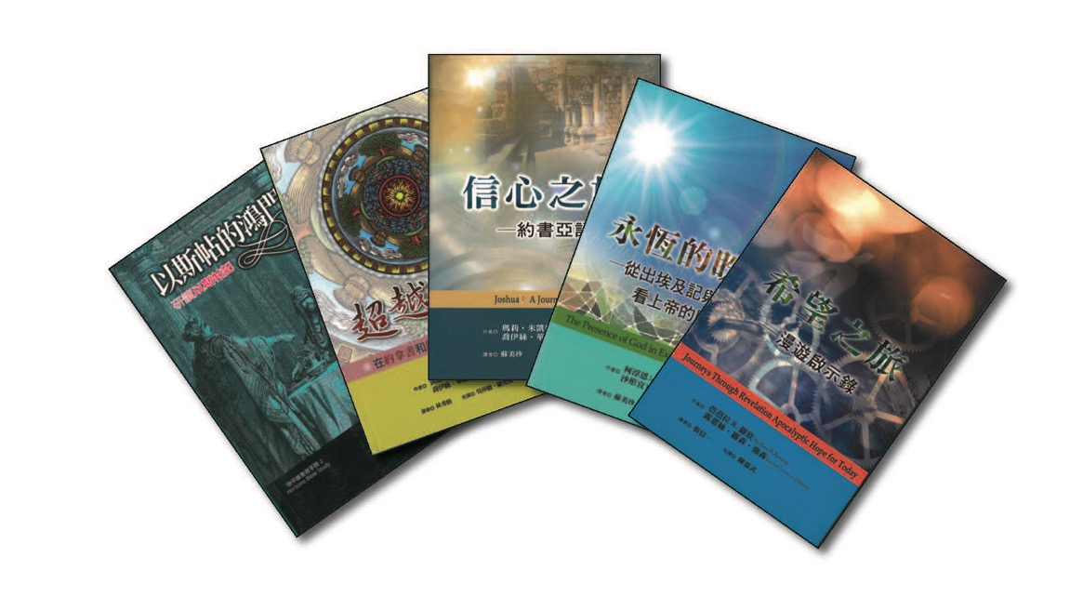
Mandarin Language Bible Study
Presbyterian Women of Taiwan PC

Slide 9
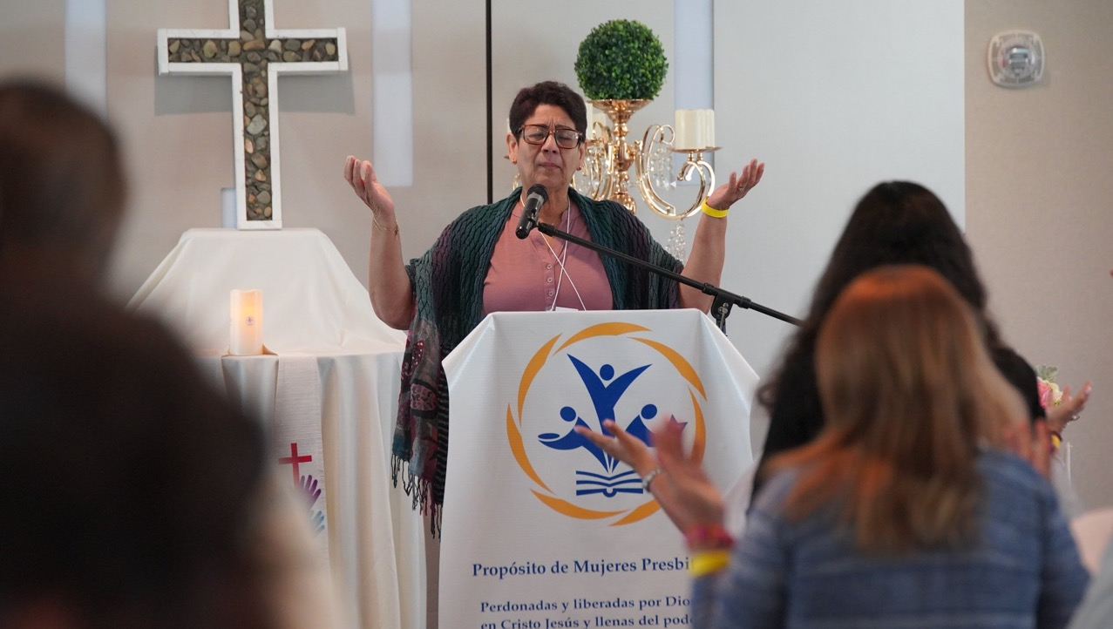

Slide 10
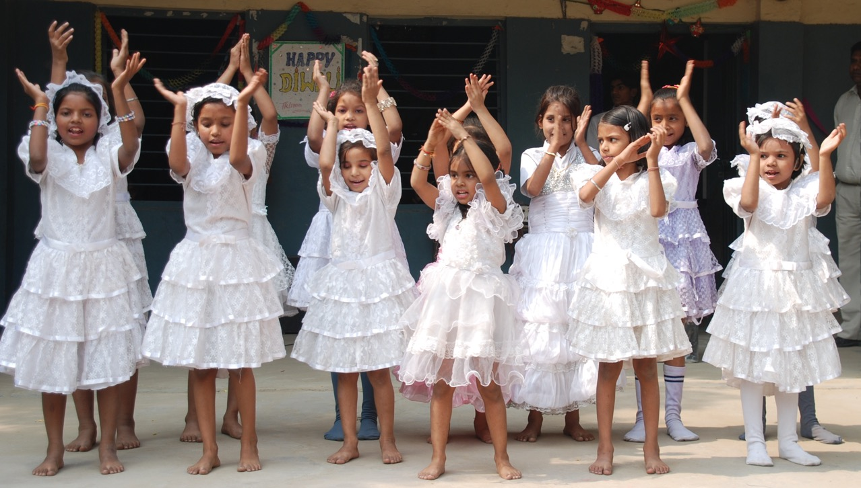
We commit ourselves to support the mission of the church worldwide

Slide 11

Birthday Offering 2024
Advocates for Community Choice dba Bethel Hills
Villa 5 Apartments and
Recreation Area
Marthasville, Missouri
Shawnee Presbyterian Church
Café Gingko
Louisville, Kentucky

Slide 12
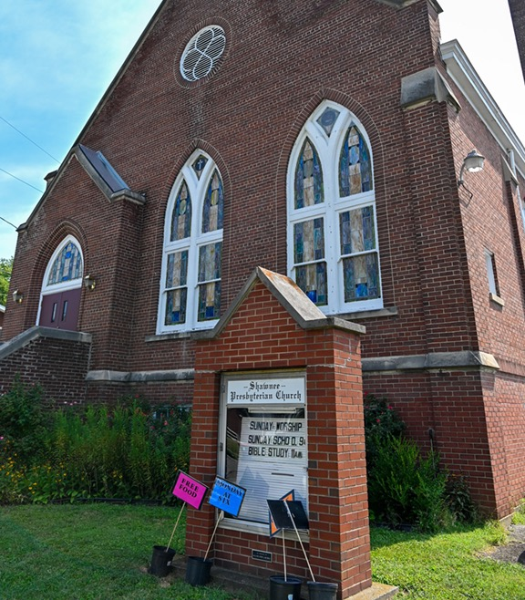
Café Ginko
Shawnee Presbyterian Church
Louisville, Kentucky

Slide 13
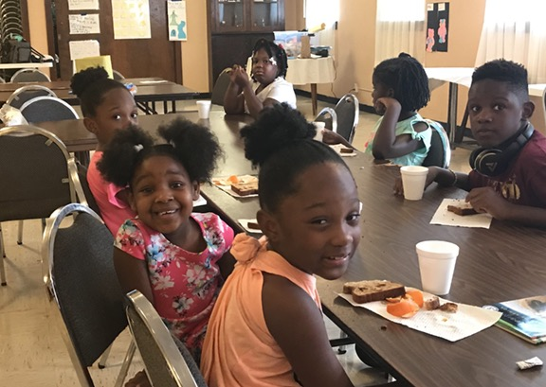
Café Ginko
Louisville, Kentucky

Slide 14
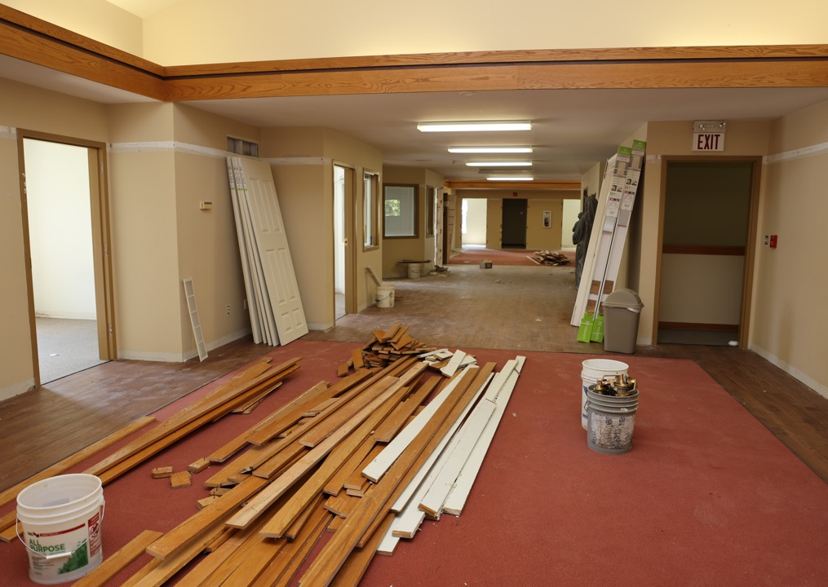
Advocates for Community Choice
dba Bethel Hills
Villa 5 Apartments and
Recreation Area

Slide 15
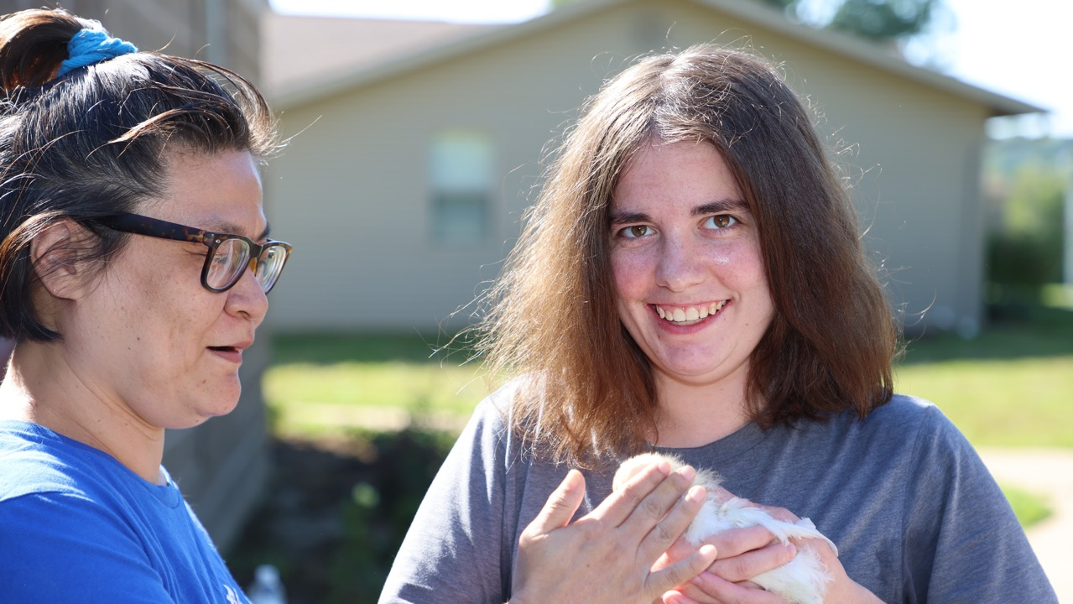

Slide 16

2024 Thank Offering
Eight Projects selected
Six domestic: $195,160
Two international: 75,000
Total dispersed: $270,160
More than 40 percent of the total grant money awarded to health-related projects.
Horizons, Summer 2024 and the PW Website

Slide 17
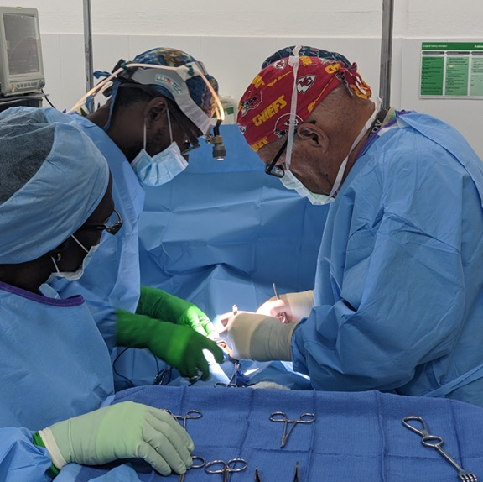
Higgins Brothers Surgicenter for Hope
Haiti and the Synod of
Mid-America
Heartland Presbytery
Village Presbyterian Church, Prairie Village, Kansas, fiscal sponsor

Slide 18
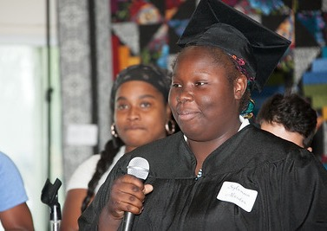
Homes to Independence
Housing for Homeless Youth
Synod of South Atlantic
Central Florida Presbytery

Slide 19
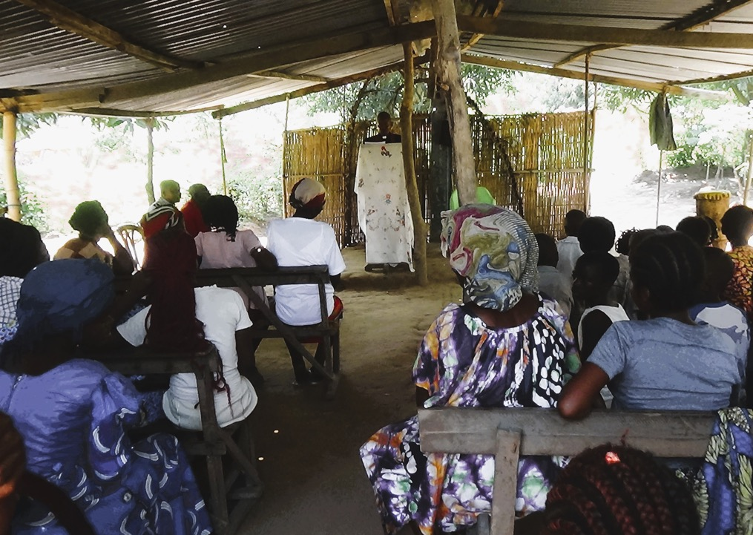
Presbyterian Ministries with Vulnerable Children
Protecting Children in Greater Kasai
Democratic Republic of Congo
Presbyterian Church in Congo

Slide 20
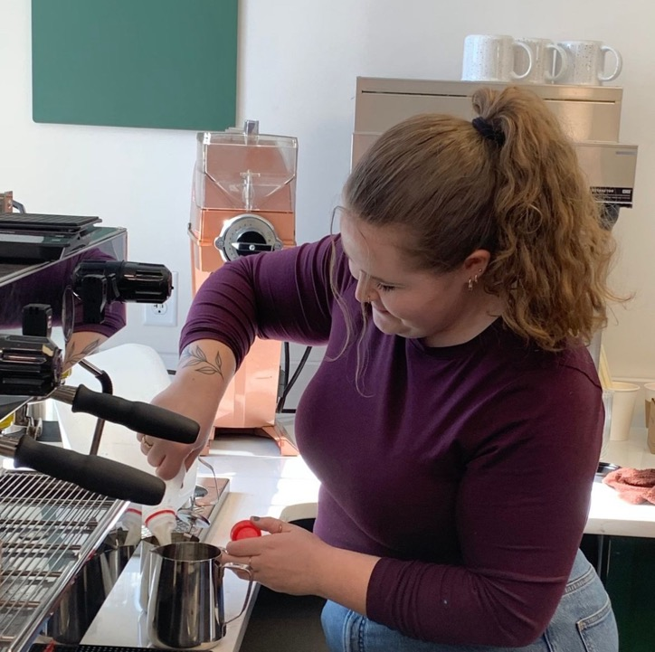
Peace Promise
Synod of the Trinity
Presbytery of Carlisle
Advocacy, education, and economic empowerment to survivors of sexual exploitation and human trafficking

Slide 21
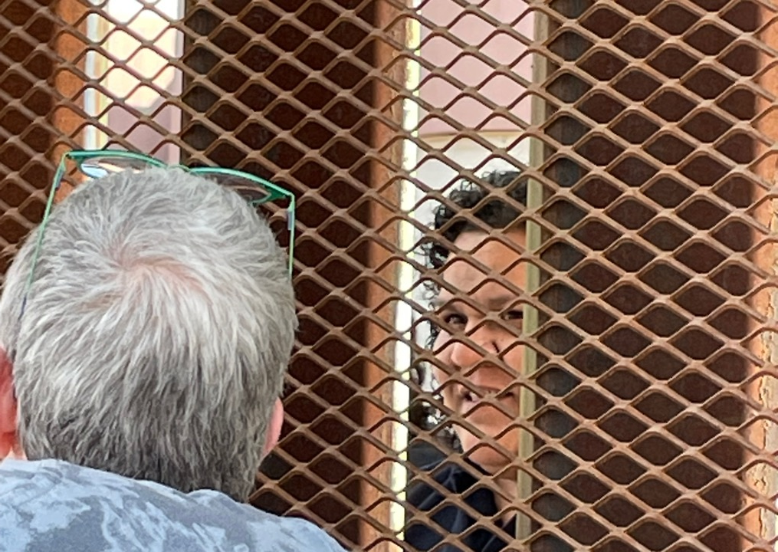
Platform for Grassroots Advocacy
Office of the General Assembly of the Presbyterian Church (U.S.A.)
Office of Immigration Issues
Public Affairs Software

Slide 22
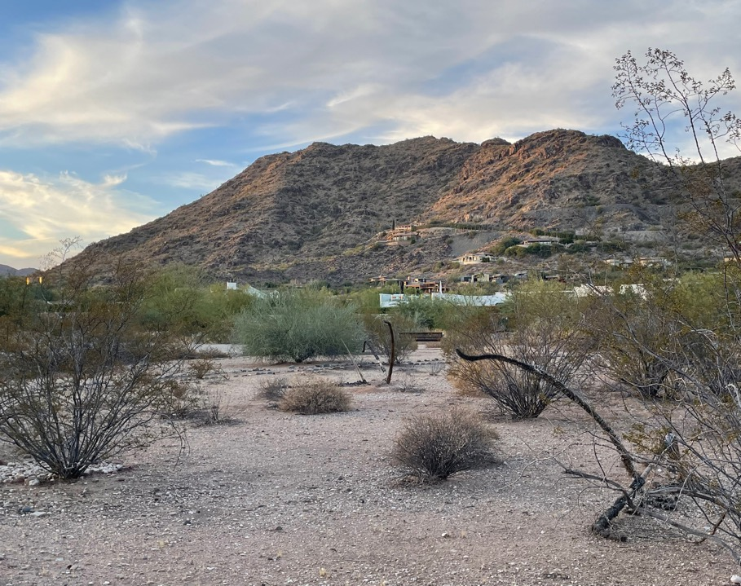
2023 PW USA
Mission Experience
Arizona and the Border Region
Notes:
Line spacing + Page numbers

Slide 23
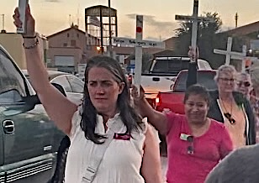
Presente
USAME participants bear witness to those who have perished attempting to enter the United States.

Slide 24
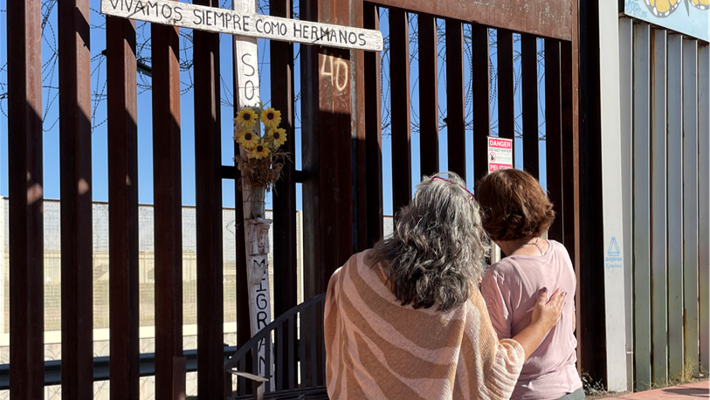

Slide 25
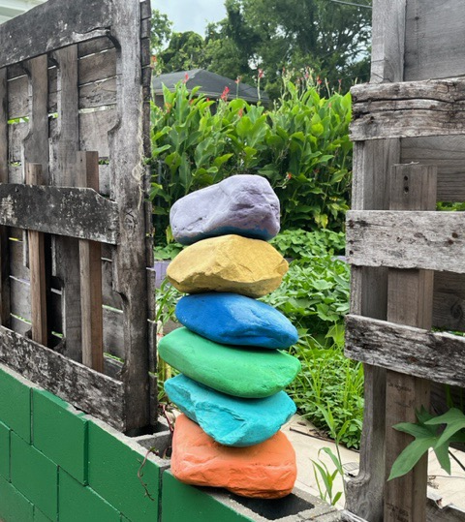
We commit ourselves to work for justice and peace

Slide 26
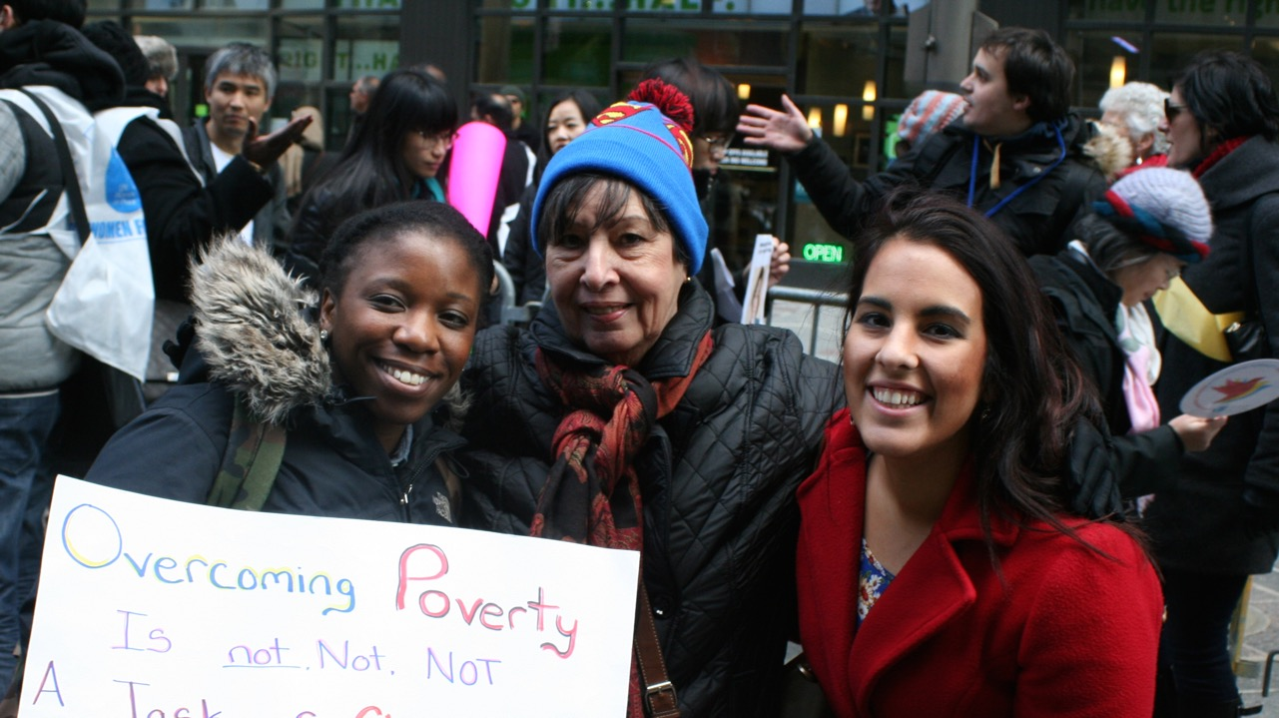

Slide 27
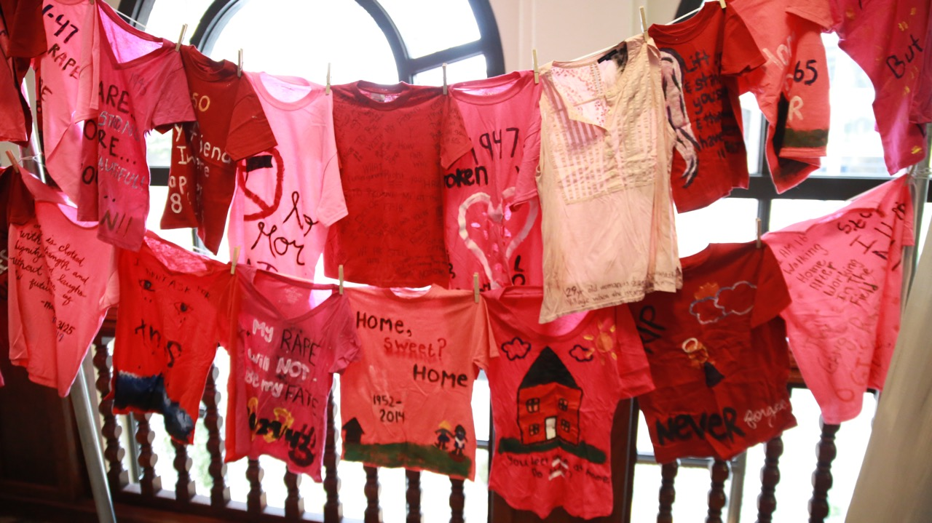

Slide 28
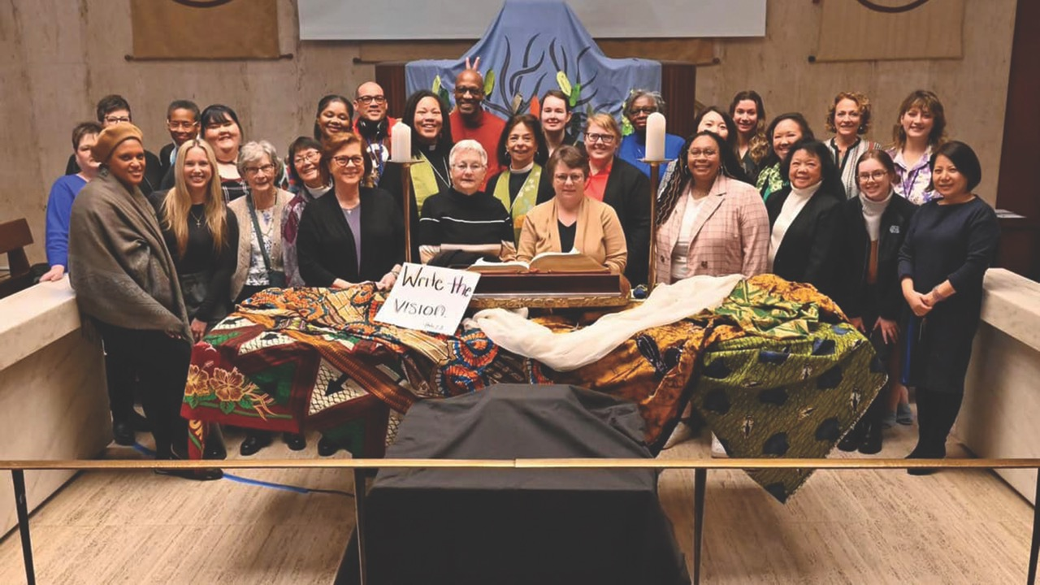

Slide 29

PW Justice & Peace
Book Discussion Group
January 8: The Immortal Life of Henrietta Lacks
March 11: Our Missing Hearts
May 13: Transforming
July 8: A Place Called Home
September 9: Poverty by America
November 11: Searching for Savanna
Register Online!

Slide 30
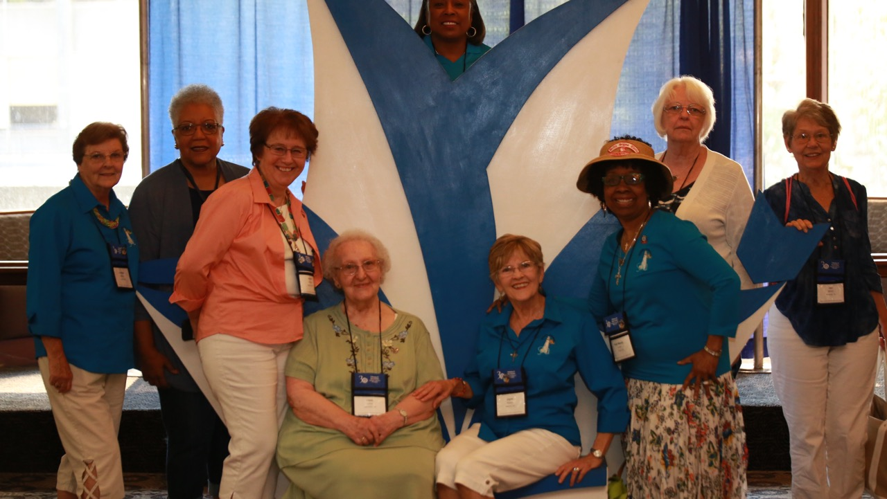
We commit ourselves to build an inclusive, caring community of women

Slide 31
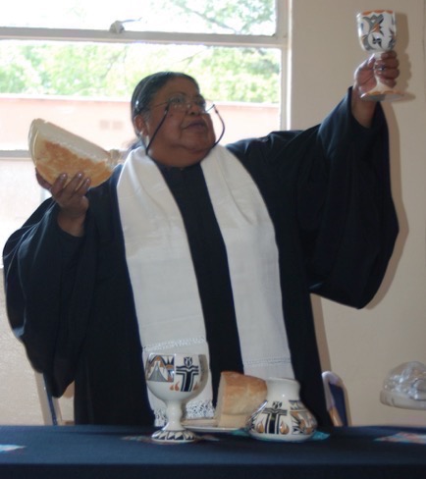
PW Groups
Asian PW
Hispanic/Latina PW
Middle Eastern PW
National Black PW
National Korean PW
Native American PW
Kenyan, Ghanaian, Cameroonian MOUs

Slide 32
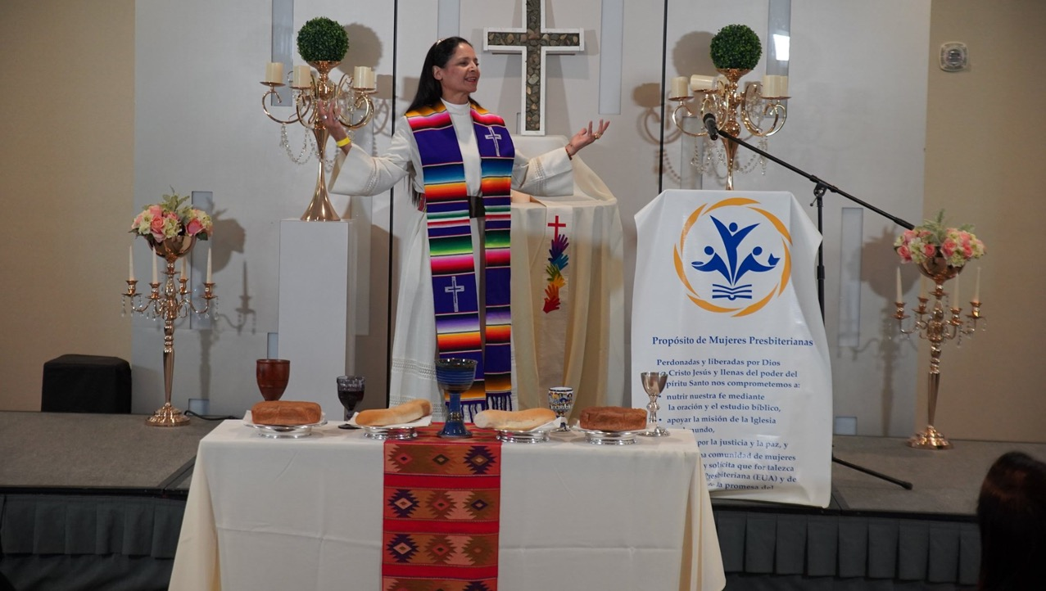

Slide 33
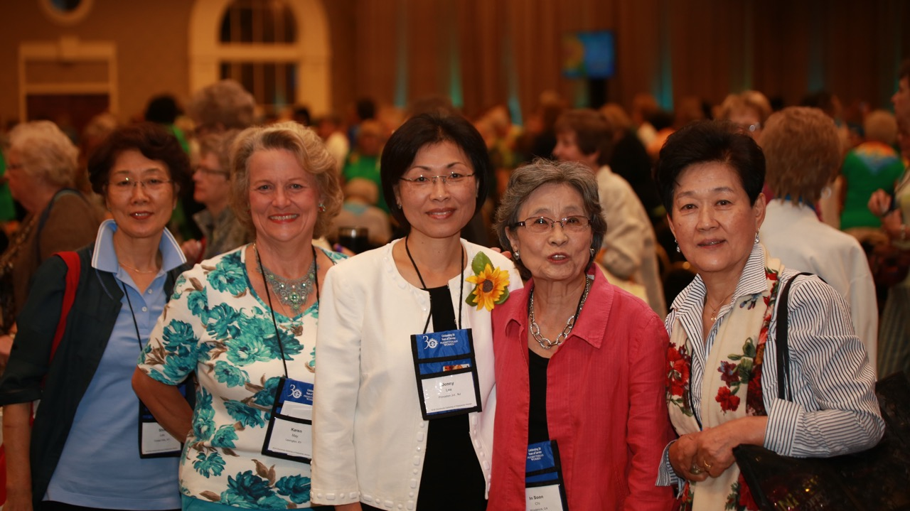

Slide 34
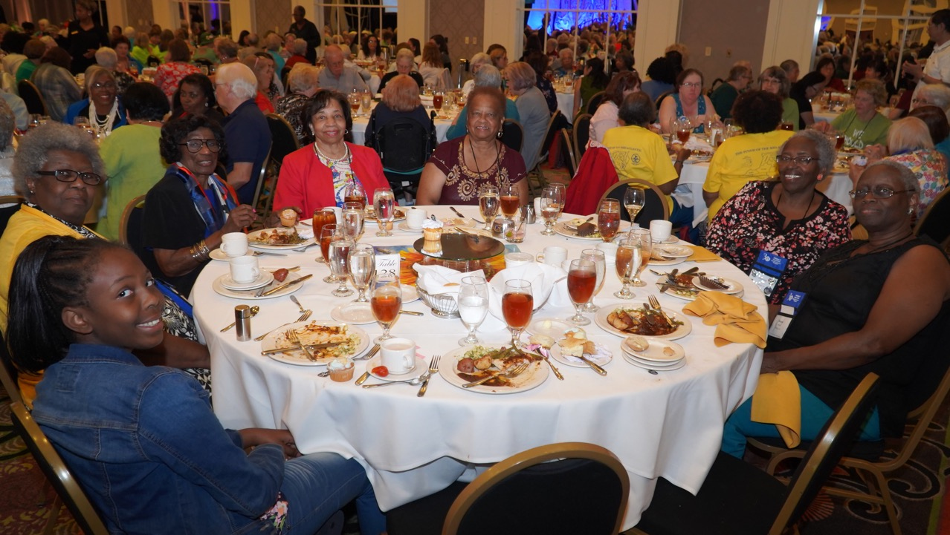

Slide 35


Slide 36
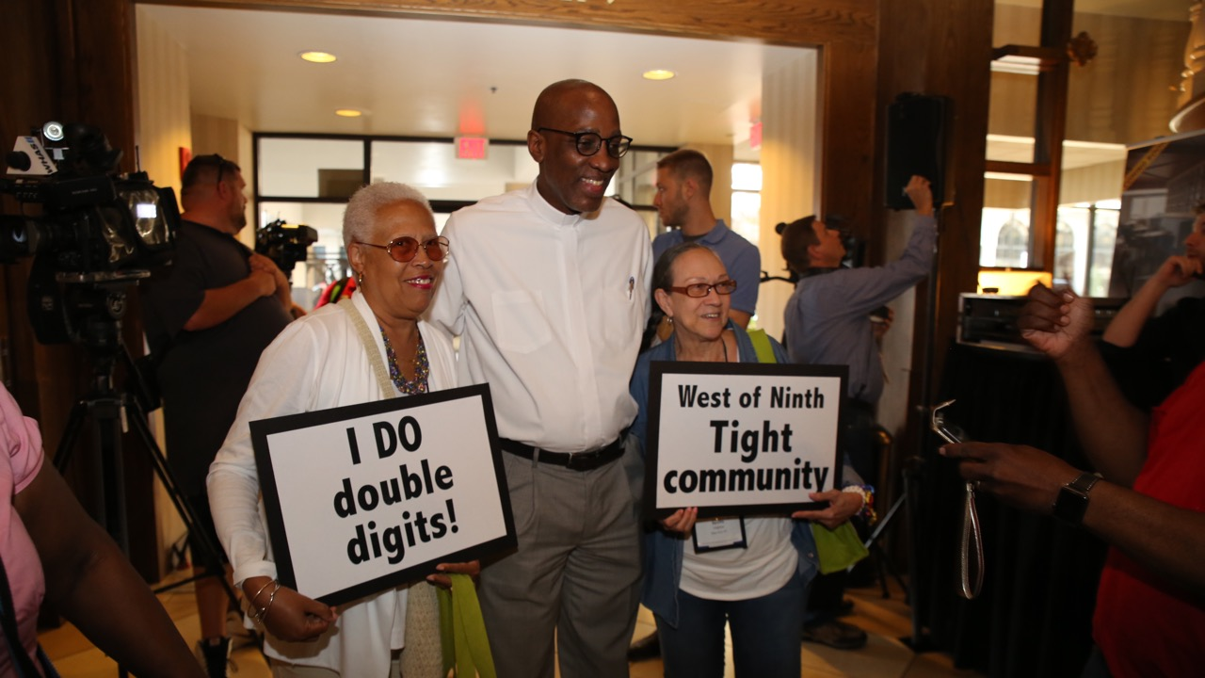
That strengthens the Presbyterian Church (U.S.A)

Slide 37
Presbyterian Women Essentials
A Guide for PW Groups
PW Manual: Guide for Groups 2016, revised 2023, updated 2024
English and Spanish editions
Available as a free download from the PW website or store
No print version
New organization and content
PW Treasurer Essentials coming soon

Slide 38
PC(USA) Agencies and Entities
Agencies
Office of the General Assembly
Presbyterian Mission Agency
Presbyterian Publishing Corporation
Presbyterian Church (U.S.A.) Foundation
Board of Pensions
Entities
Presbyterian Church (U.S.A.), A Corporation
Presbyterian Women in the PC(USA), Inc.

Slide 39
PW, Inc., and PC(USA)
Independent 501(c)(3) (2009)
Integrated auxiliary of PC(USA) without control
PW moderator on PMAB, PMAB representative on PW Board
Member, PC(USA) A Corporation Board (A Corp)
Institutional Relationship Agreement for collaboration
Related corporation, PC(USA) Organization for Mission (2016)
Service agreement with PC(USA) for administration, lease
Corresponding member to the General Assembly (2016)

Slide 40
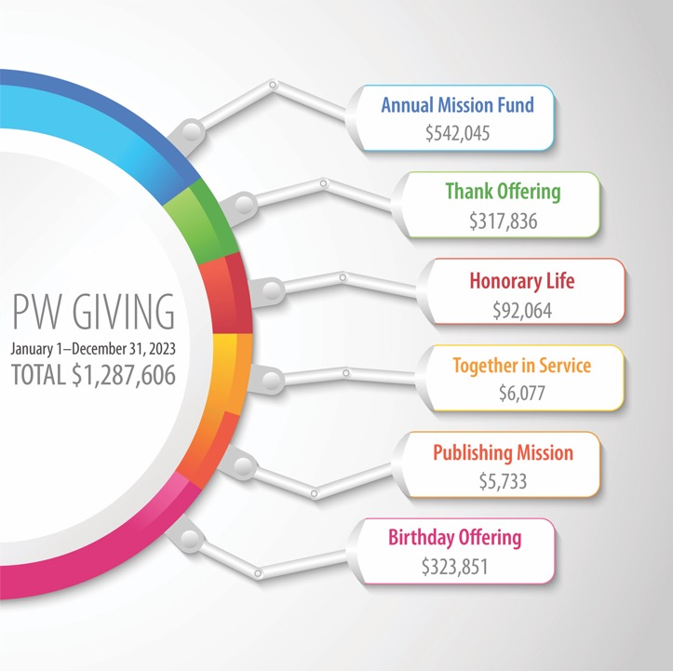
PW Giving 2023
Annual Mission Fund: $542,045
Thank Offering: $317,836
Birthday Offering: $323,851
Publishing Mission: $5,733
Together in Service: $6,077
Honorary Life: $92,064
Total: $1,287,606

Slide 41

Annual Fund 2025
With other revenues, supports
Infrastructure that makes program possible
PW program delivery and development
PC(USA) mission
PMA program
Leadership training
Management and Board
PW Business Meeting
Ecumenical partners
Notes:
Look at triennial report for budget.

Slide 42
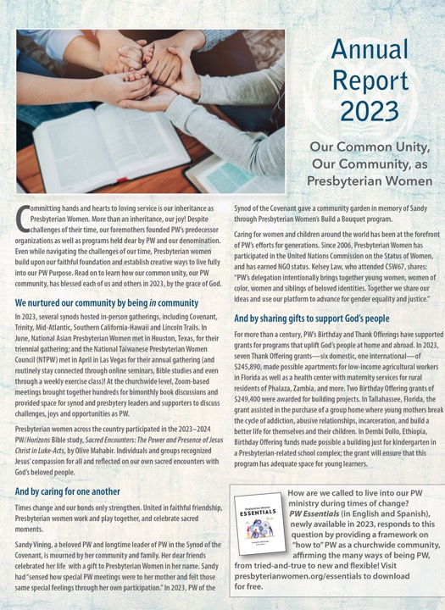
PW Annual Report
Our Common Unity, Our Community,
as Presbyterian Women
Download from the PW website
https://www.presbyterianwomen.org/downloads/
2023-annual-report-of-presbyterian-women/

Slide 43

Stewardship
PW Gives Day, July 31, 2024
Celebrate PW’s Founders’ Day!
$10,056 as of August 2
Presbyterian Church (U.S.A.) Foundation: Legacy Giving and
Endowments
Honorary Life Memberships
Resources: Love Grows by Giving Bookmarks, Annual Report, Annual Fund 2025 Flier

Slide 44

Build a Bouquet
https://www.presbyterianwomen.org/
giving-funding/give/build-a-bouquet/

Slide 45

and witnesses to the promise of God’s kingdom

Slide 46

Horizons 2024
J/F: Simply the Best
M/A: Sacred Spaces
Summer: Do Everything in Love
S/O: Listening
N/D: Understanding and Misunderstanding Jesus

Slide 47
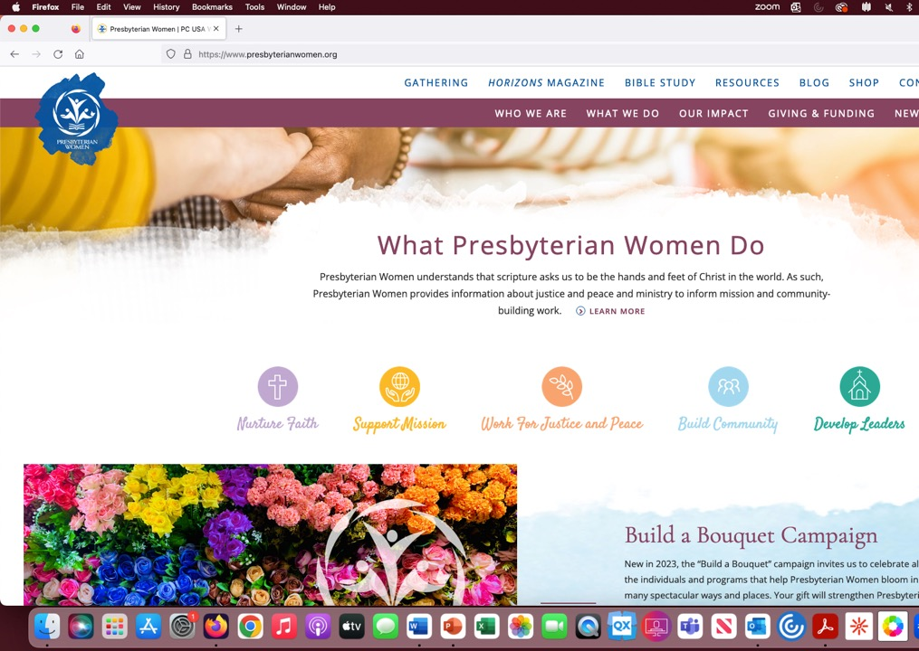
Networking and Leadership Tools
PW Presbytery and Synod Network Meetings
Horizons Magazine
PW Website and Social Media
PW NewsBytes
E-Blasts
Board Summaries
Networks (People)
844/PW-PCUSA
Notes:
Online only—reinventing

Slide 48
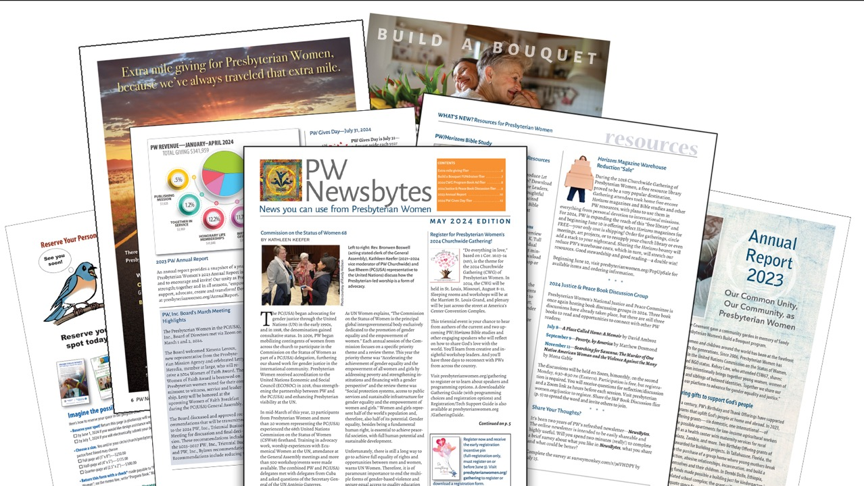

Slide 49
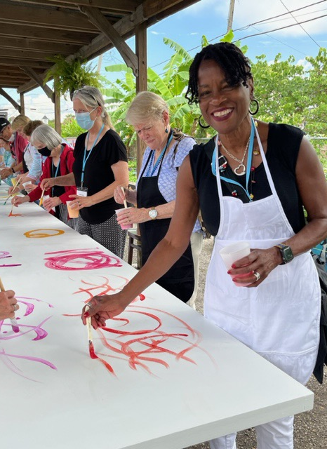
Okra Abbey
2023 Birthday Offering Recipient
2023 Synod of the Sun PW Gathering

Slide 50
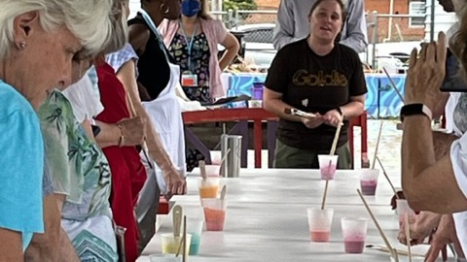

Slide 51
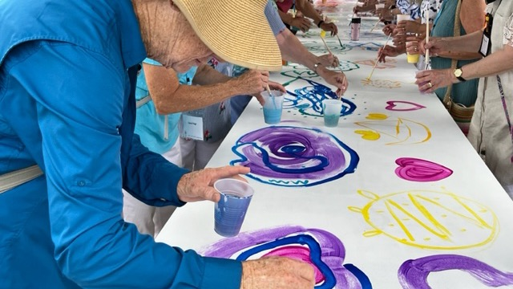

Slide 52


Slide 53

Churchwide Gathering 2024
Notes:
Do Everything in Love, 1 Corinthians 16:13–14 (NIV)

Slide 54


